Slide 1
Group 4 Case study
By: Alex Holland, Anna Nguyen, & Meagan Gutierrez

Slide 2
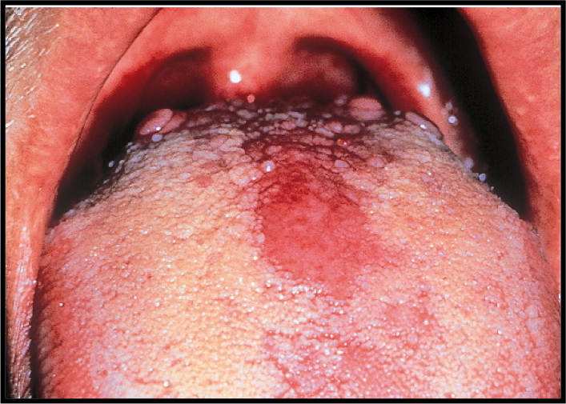
Case study
A 29-year-old male visited a dental office for a routine checkup. During the oral examination, a large, red area was noted on the tongue.

Slide 3
History
The patient was aware of the red patch on his tongue and claimed it had been present for several weeks. No pain, burning, or sensitivity was noted in the affected area. The patient also reported the lesion had not appeared to increase or decrease in size. The patient appeared to be in an overall good state of health. No health problems were noted, and the patient was not taking medications at the time of the dental examination. The patient’s dental history included regular examinations and routine treatment.

Slide 4
examinations
The patients vital signs were all found to be within normal limits. Examination of the head and neck region revealed no enlargement or palpable lymph nodes. Extraoral examination revealed no significant or unusual findings. Intraoral examination revealed a large red patch on the posterior dorsal tongue. The affected area appeared to lack the normal keratotic white filiform papillae. Further oral examination revealed no other lesions present.

Slide 5
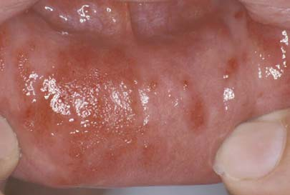
Allergic reaction
Altered state of reactivity in which the body reacts to a foreign agent, or allergen, with an exaggerated immune response.

Slide 6
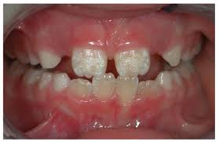
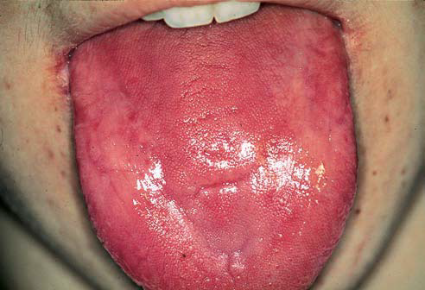
Vitamin Deficiency
Vitamin A, C, & D deficiency: Enamel hypoplasia characterized by pitting of the enamel.
Vitamin B deficiency: Pernicious anemia – Oral manifestations: Angular chelitis, mucosal pallor; painful, atrophic, and erythematous mucosa; mucosal ulceration; loss of papillae on the dorsum of the tongue; and burning and painful tongue.

Slide 7
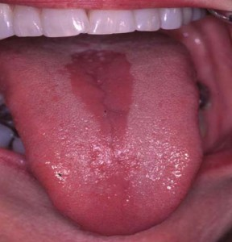
Median rhomboid glossitis
Cause: Unknown/ associated with candida
Location: Midline of dorsal tongue
Clinical Features: Flat or slightly raised erythematous, rectangular area anterior to circumvallate papillae
Treatment: None

Slide 8
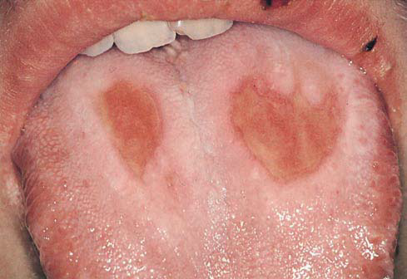
Thermal injury
Cause: Hot food or liquid
Location: Site of contact
Clinical features: Painful erythema & superficial ulceration
Treatment: None/ Palliative

Slide 9
Geographic tongue
Cause: Genetic / Associated with stress/ some cases associated with psoriasis
Location: Dorsal & lateral boarders of tongue
Clinical features: Erythematous, depapillated areas with white boarders occasional complaint of burning discomfort
Treatment: None, avoid spicy foods

Slide 10
Based on the clinical information, which of the following is the most likely clinical diagnosis?
Allergic reaction
Vitamin deficiency
Median rhomboid glossitis
Thermal injury
Geographic tongue

