Slide 1
Musculoskeletal Disorders in the Dental Field
By: Alex Holland & Lauren Morris

Slide 2
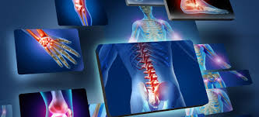
What is MSD?
“MSD stands for musculoskeletal disorder, it is a condition where parts of the musculoskeletal system, including: muscles, tendons, and nerves, are injured over time.”
“Occurs when too much stress is exerted on a body part, resulting in pain”
“When a body part is overused repeatedly, the constant stress causes damage”
Mainly affects the neck, shoulders, hands, upper and lower back
Notes:
So what is MSD? How does it pertain to us as hygienists? We’ll we will tell you.

Slide 3
Prevalence of MSD in the Dental field
“Over 60% of dentists & dental hygienists have experienced musculoskeletal pain.”
Begins early
“MSDs continue to be a major source of disability and lost work time in dental professionals.”
Notes:
We found in our research that in the prevalence of MSD over 60% of dentist and dental hygienists have experienced musculoskeletal pain. It begins early and continues to be a major source of disability and lost work time in dental professionals.

Slide 4
Common signs and symptoms to be aware of
Decreased range of motion
Decreased grip strength
Loss of function
Muscle fatigue
Numbness
Burning
Pain
Tingling
Notes:
Decreased range of motion, grip strength, and loss of function will mainly occur in the hands and wrists.
However muscle fatigue, numbness, burning, pain, & tingling will be felt throughout the upper body. (Lower back, neck, and shoulders)
Lauren

Slide 5
Ergonomic Risk Factors to avoid
Awkward positions
Repetition
Static postures
Visual fatigue due to poor visualization.
Excessive force
Prolonged exertions
Heavy instruments
Tight grip
Notes:
Awkward positions can be avoided by maintaining a neutral position throughout the day.
Repetition can be relieved by relaxing grip between scaling quadrants.
Chairside exercises, and just walking around the office will help with reducing the stress of static posture.
Loupes will greatly decrease poor visualization during scaling and intra oral procedures
Excessive force and prolonged exertions can be diminished by keeping your instruments nice and sharp
Heavy instruments can be replaced with lighter instruments
A tight grip can possible be loosened by having instruments with a wider diameter

Slide 6
Back to the Basics
Building Blocks of Periodontal Instrumentation
Position, grasp, mirror, finger rests, & stroke.
Establishing position:
Me
My patient
My equipment
My non-dominant hand
My dominant hand
Stroke
Finger Rests
Mirror
Grasp
Position
Notes:
As hygienists in private practice and even in school we sometimes forget to go back to our neutral positions.
Remember the building blocks of instrumentation & the sequence for establishing position? Here is a reminder:
Lauren

Slide 7
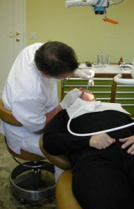
Back to the Basics: Positioning
POSITIONING, POSITIONING, POSITIONING
THE RIGHT CHAIR POSITIONS & NEUTRAL POSITIONING CAN HELP FIX ALL YOUR MSD SYMPTOMS!
Notes:
We have all heard it as students over and over and over again. However as a registered dental hygienist in an office setting, you probably NEVER get corrected on how you are seating in your chair or how your patient is positioned in your chair. Are they too high? Are they too low? Is your back straight? Are you starting to feel tension in your neck?
The right chair positions and neutral positioning can help fix all of your MSD symptom needs.
As dental hygienists and students we should always go back to the basics for any positioning before starting our long day of repetitive procedures. Because working at least 8 hours a day, occasionally putting ourselves in slumped, awkward positions will only increase our chances of MSD, it is imperative that we recall our neutral positioning.

Slide 8
Back to the Basics: Positioning
Clinician chair Adjustments
Adjust the back rest height so that it is seated into your lower back curve
Adjust the height with your feet flat on the floor until your thighs slope slightly downward.
Relax your shoulders so that they are down and back.
Notes:
In our research we found that chair adjustments were the most important of all the basic steps to remember when preventing MSD symptoms. Because what is a neutral position if you’re chair doesn’t fit you right?

Slide 9
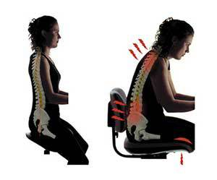
Notes:
In this slide you can see the difference between good neutral positioning and the pains that can happen through incorrect posture.

Slide 10
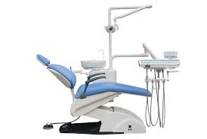
Back to the Basics: Positioning
Patient Postitions
Maxillary:
Supine with chin up
Mandibular:
Semi-supine with chin tilted down
Neutral positions
Neck
Should be as straight.
Back
Avoid a curved back
Shoulders
Horizontal line
Upper arms
Elbows at waist slightly away from body
Forearms
Parallel to the floor
Hands
Aligned with forearm
Notes:
Remember neutral positions from you’re very very first semester of dental hygiene school? I bet you thought you would never have to see them again. We’ll we are here to remind you of their importance to our MSD prevention. Of course ergonomic chairs, loupes, and instruments help but honestly it is all about going back to the start and remembering the simple things.
The patients chair position is crucial when it comes to reducing stress on your head, neck, arms and back.
Maxillary position: Patient should be in supine position with their chin tilted up
Mandibular position: Patient should be in a semi-supine position with their chin tilted down

Slide 11
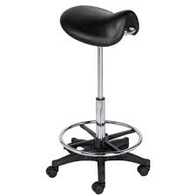
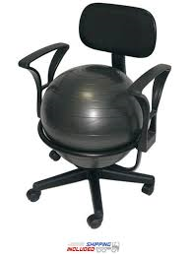
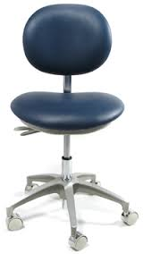
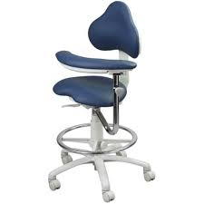
Ergonomic Chairs
Dynamic seat
Saddle stool
Ball chair
Notes:
Lauren

Slide 12
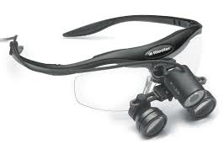
Loupes
Help to decrease the need to lean forward while working
Decrease in eye strain
Increase in production for hygienist & dentist
Key component to relieving daily aches and pains
Notes:
Lauren
Loupes help to decrease the need to lean forward for a better view of the oral cavity or area the clinician is trying to see.
There is a decrease in eye strain when wearing loupes.
“Production has increased as a direct result of wearing the loupes and light. The dentist’s production also increases when the dental hygienist can codiagnose patient restorative and periodontal needs.”

Slide 13
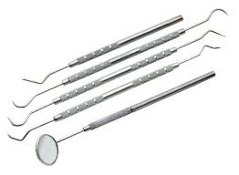
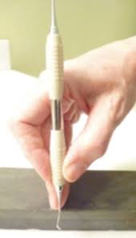
Back to the Basics: Instrument Grasp
Modified pen grasp
Stable fulcrum
Helps with strokes
Prevents unexpected actions
Helps decrease the muscle load
Sharp Instruments
Help remove calculus easier
Improve strokes
Decrease number of strokes
Decrease clinician exhaustion
Notes:
Lauren
The clinician should be using a modified pen grasp when holding an instrument and have a stable fulcrum. The fulcrum helps with the strokes, prevents unexpected actions, and helps decrease the muscle load.
The clinician should make sure their instruments cutting edges are sharpened. This will make removing calculus easier, improve strokes, decrease number of strokes, and decrease clinician exhaustion.

Slide 14
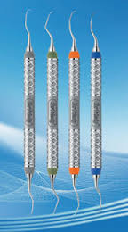
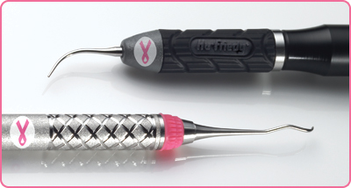
Ergonomic Instruments
There are three main characteristics when choosing instruments:
1.) light weight
2.) large diameter
3.) texture of the handle
All of these characteristics help reduce the stress that is
put on our muscles while working.
Notes:
Lauren

Slide 15
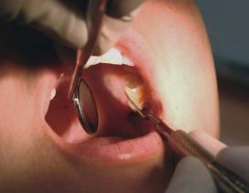
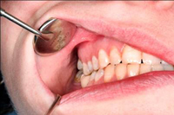
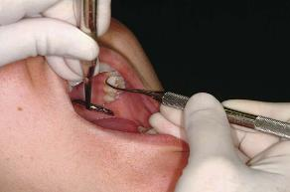
Back to the Basics: Mirror & finger Rests
Why is it so important to be best friends with our mirror?
Another factor with helping position of neutral back
Finger rests
Stabilization during scaling
Reduce muscle stress
Prevent injury due to muscle fatigue
Notes:
Lauren

Slide 16
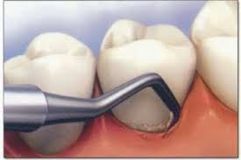
Back to the Basics: Strokes
Short
Controlled
Biting strokes
Notes:
Lauren
Short, controlled biting strokes is important to help minimize extreme flexion, hyperextension and rotation of the wrist when scaling

Slide 17
CAM Therapies (Complementary & Alternative medicine)
Yoga (mind-body therapy)
Massage therapy
Notes:
CAM therapies other wise known as complementary & alternative medicines are a wonderful nonevasive way to help treat symptoms, relieve, & prevent the stresses of MSD.
Yoga is such a good therapy for MSD because it helps train your breathing, it stretches out all of your muscles, and it is very relaxing. MSD builds up tension from working in awkward positions all day long and even if you aren’t in an awkward position for every patient it still happens. All of those hard to reach spots in the mouth that we bend our necks or hunch our backs to reach builds up over time especially 8 hours a day at least 4 days a week. So trying yoga at home or going to a class after work or school can really help decrease the symptoms of MSD by keeping our bodies stretched, relaxed, and healthy.

Slide 18
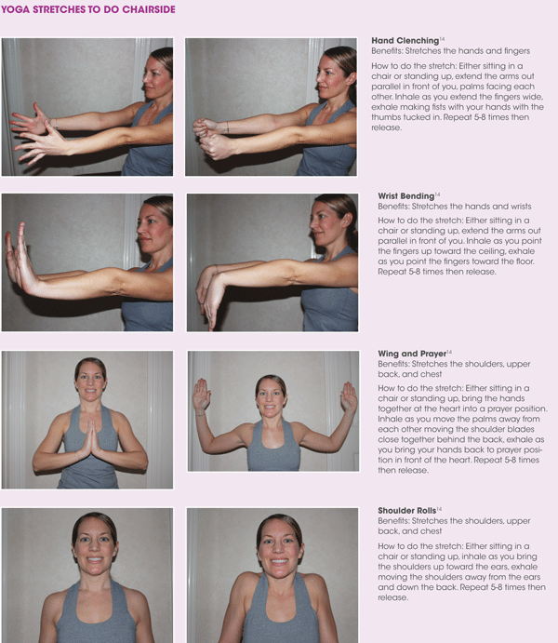
Hand Clenching
Wrist Bending
Wing & Prayer
Shoulder Rolls
Notes:
Hand Clenching – Benefits: stretches the hands and fingers
Can be done sitting or standing.
Extend arms out parallel in front of you, palms facing each other.
Inhale as you extend the fingers wide,
Exhale making fists with your hands with thumbs tucked in.
Repeat 5-8 times then release.
Wrist Bending – Benefits: Stretches the hands and wrists
Can be done sitting or standing.
Extend the arms out parallel in front of you.
Inhale as you point the fingers up toward the ceiling,
Exhale as you point the fingers toward the floor.
Repeat 5-8 times then release
Wing and Prayer – Benefits: Stretches the shoulders, upper back, and chest
Can be done sitting or standing.
Bring the hands together at the heart into a prayer position.
Inhale as you move the palms away from each other moving the shoulder blades close together behind the back,
Exhale as you bring your hands back to prayer position in front of the heart.
Repeat 5-8 times then release
Shoulder rolls – Benefits: Stretches the shoulders upper back and chest
Sitting or standing.
Inhale as you bring the shoulders up toward the ears,
Exhale moving the shoulders away front the ears and down the back.
Repeat 5-8 times then release.

Slide 19
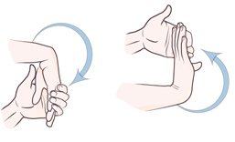
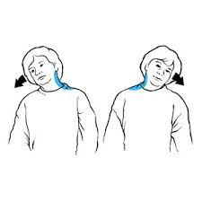
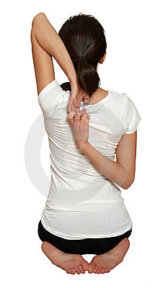
Benefits of Chair side Stretches
Relief of aches from being seated all day
Stretching out the wrists, shoulders, forearms, and neck.
Notes:
The relief of getting up from a seated position and walking around while doing these small stretches to relieve aches.

Slide 20
At Home Yoga
Notes:
There are many yoga positions here but the best one is the Warrior II because it is good for carpal tunnel!
Warrior II – Benefits: Strengthens ankles, legs, arms, shoulders, chest, back, wrists (GOOD FOR CARPAL TUNNEL)
- Torso will be parallel with a wall,
Turn one foot forward bending the knee (knee is directly above the ankle).
Back leg is straight,
Keep the shoulders directly above the hips,
Extend the arms out to the side taking the eye gaze over the front arm.
Hold for 4-5 breaths then repeat on other side

Slide 21
Our Goal
Be aware of the new habits you have made throughout your career.
Slowly but surely try to break those new habits by going back to the basics with EVERY PATIENT!
Incorporate chair side stretches into your daily routine.
Try a yoga class or at home yoga to help stretch out aches and pains from the day.
Notes:
Be aware of new habits made throughout career
Incorporate chair side stretches into daily routine
Try a yoga class or at home yoga to help with stretching out aches and pains
Above all remember to go back to the basics with each patient!

Slide 22
References
“Dental hygiene Economics.” – Registered Dental Hygienist. Web. 27 Sept. 2015. http://www.rdhmag.com/articles/print/volume-31/issue-8/features/dental-hygiene-economics.html.
http://www.rdhmag.com/articles/print/volume-32/issue-1/features/postitioning-for-success.html
http://www.dentistryiq.com/articles/2014/06/where-do-you-stand-with-your-dental-ergonomics.html
http://www.ada.org/en/publications/ada-professional-product-review-ppr/archives/2014/november/ergonomics-and-dental-practice-preventing-work-related-musculoskeletal-problems
Warren, N. (2010). Causes of musculoskeletal disorders in dental hygienists and dental hygiene students: A study of combined biomechanical and psychosocial risk factors. Work, 35(4), 441-454. doi:10.3233/WOR-2010-0981
Noh, H., & Roh, H. (2013). Approach of Industrial Physical Therapy to Assessment of the Musculoskeletal System and Ergonomic Risk Factors of the Dental Hygienist. Journal Of Physical Therapy Science, 25(7), 821-826. doi:10.1589/jpts.25.821
Hayes, M. J., Smith, D. R., & Taylor, J. A. (2014). Musculoskeletal Disorders in a 3 Year Longitudinal Cohort of Dental Hygiene Students. Journal Of Dental Hygiene, 88(1), 36-41.
Simmer-Beck, M., & Branson, B. G. (2010). An evidence-based review of ergonomic features of dental hygiene instruments. Work, 35(4), 477-485. doi:10.3233/WOR-2010-0984
Nield-Gehrig, J. (2013). Principles of Positioning. In Fundamentals of periodontal instrumentation and advanced root instrumentation (7th ed., pp. 11-12).

